Slide 1

Mocking Services
Recording and Playback with WireMock and Postman

Slide 2
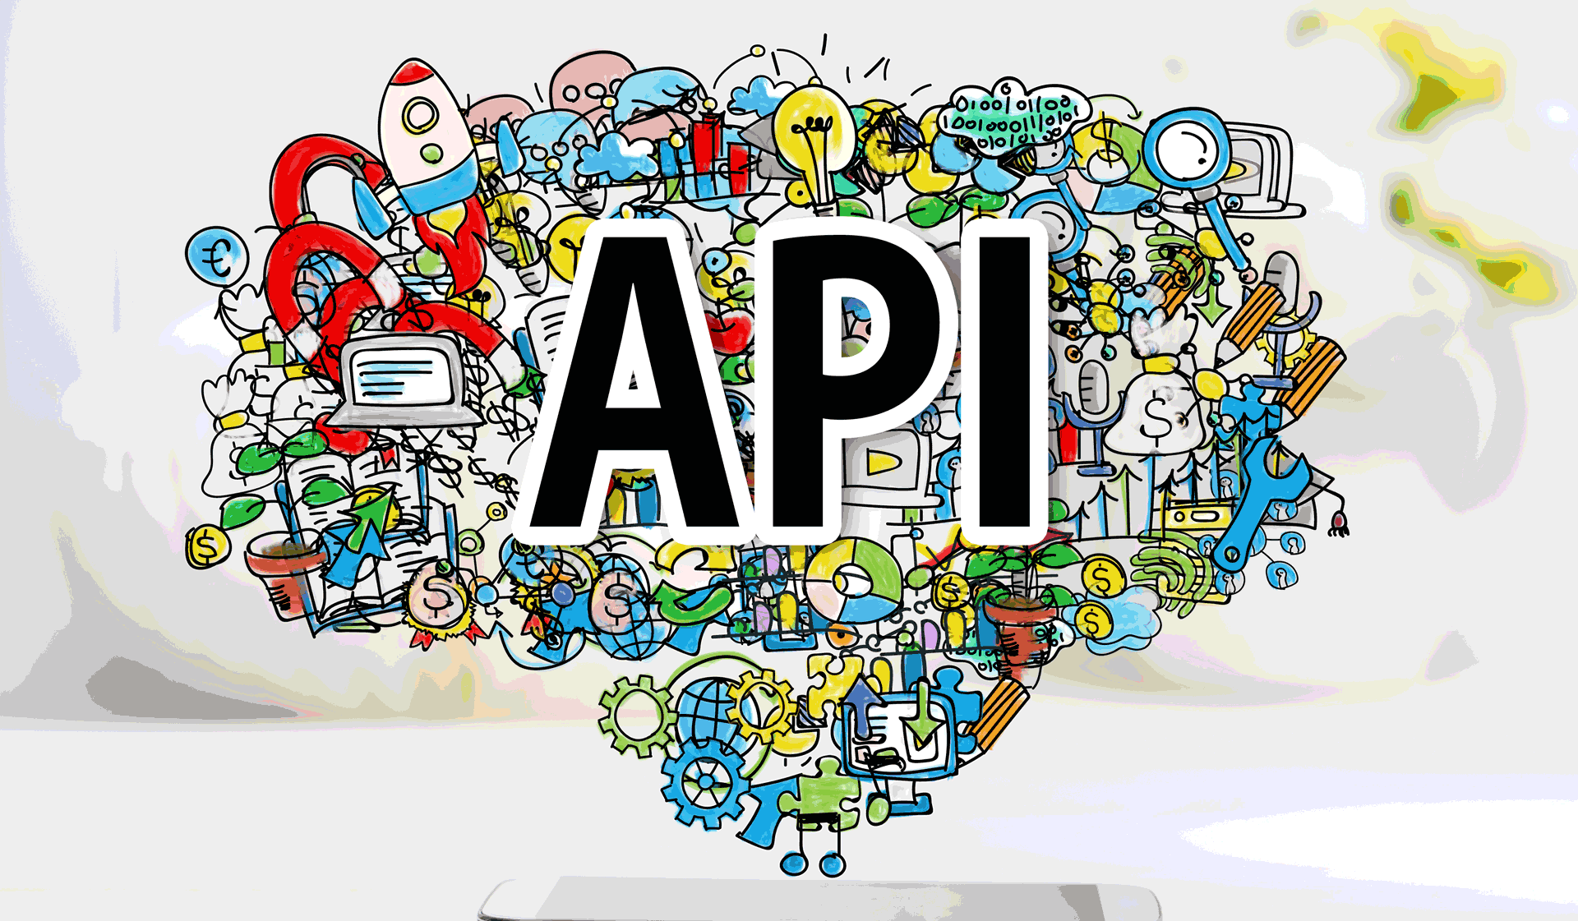



OpenWeather API
Notes:
Application programming interface
In computer programming, an application programming interface is a set of subroutine definitions, communication protocols, and tools for building software. In general terms, it is a set of clearly defined methods of communication among various components.
The API I used is called openweather – they provide a variety of different API’s that return different forecasts. I’m interested in the current weather one:
http://api.openweathermap.org/data/2.5/weather

Slide 3

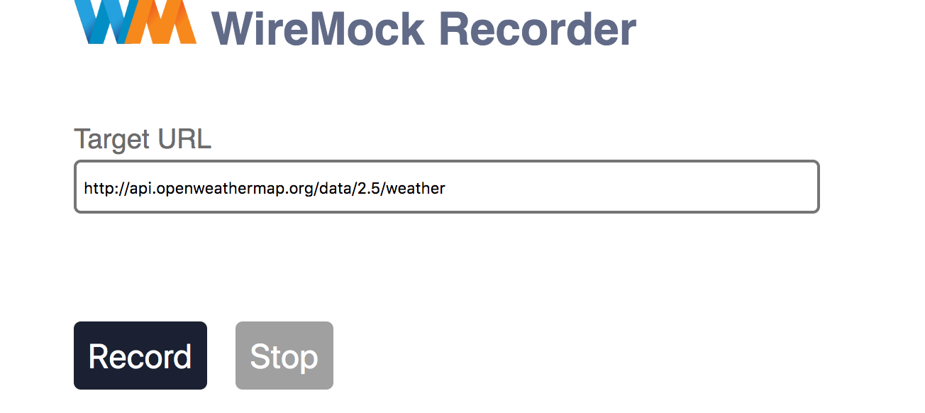

Recording with WireMock
Notes:
We’ll need to start up wiremock as a stand alone process for this.
There are many command line options available for wiremock
Were interested in:
--proxy-all http://api.openweathermap.org/data/2.5/weather
--record-mappings
Proxy all simply means that all requests maid to wiremock (localhost:8080) will be forwarded onto the specified URL
Record mappings means to record incoming requests as stub mappings.
Once started you’ll navigate to http://localhost:8080/__admin/recorder
Here you’ll enter the URL you wish to record from – press record and head over to postman

Slide 4


Send a request with Postman
Notes:
Before you start firing off requests it’s best to read the API documentation to make sure you’re actually providing it with everything it needs to send you usable data.
In this case we need the following query parameters':
Appid (a unique identifier)
The city name
It’s optional to create environments, collections, and use variables – but it is highly recommended since it will make your life easier in the long run.
In this case I opted to create a variable called “environment” as this will allow me to easily switch between my local wiremock instance and the actual API
After the domain we add the query parameters denoted by a ”?”
In this case we’re passing the appid and the city name (q)
Once the request has been created it’s as simple as editing the q value for different cities and clicking send each time to record the appropriate response

Slide 5
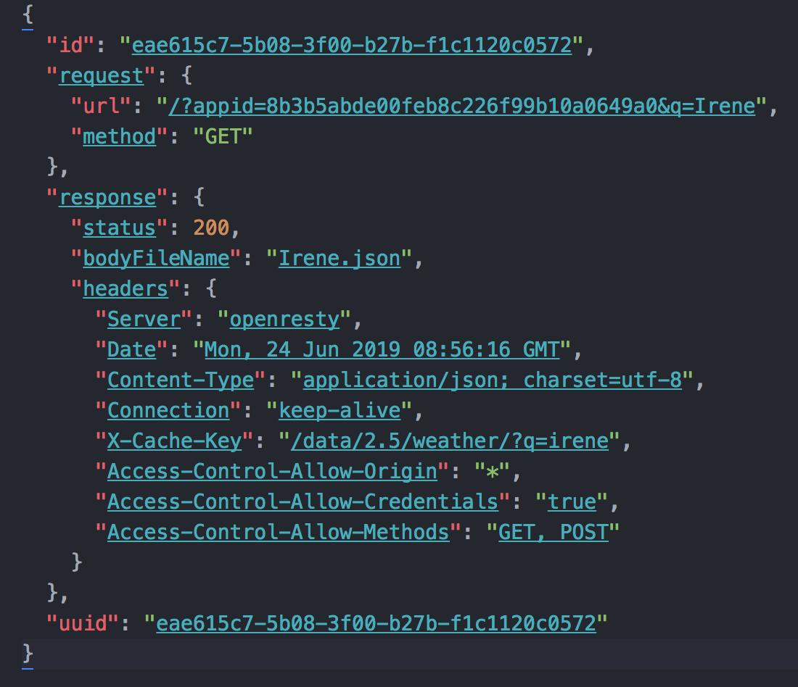
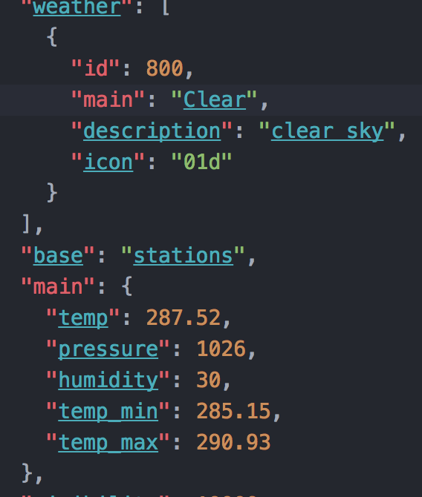

What do we get back
Notes:
What you get back from the API will differ DRAMATICALY between API’s
In this case we get back a JSON response
JSON (JavaScript Object Notation) is a lightweight data-interchange format.
It is easy for humans to read and write. It is easy for machines to parse and generate.
JSON is a text format that is completely language independent but uses conventions that are familiar to programmers of the C-family of languages, including C, C++, C#, Java, JavaScript, Perl, Python
Chances are that it’ll be “minified” to use as little bandwidth as possibly – in this case we can “prettify” the JSON to make it a bit more readable
In this response is everything we need for Clima to show the current weather conditions

Slide 6
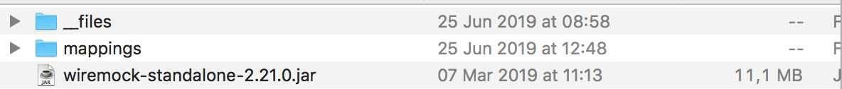
How WireMock saves data
Notes:
Now that we’ve recorded the response form the API we can head back to WireMock recorder and hit stop
Wiremock then created two folders – files and mappings
Everything in the files folder is actual content that was returned, and subsequently recorded by wiremock
Now we just need to know what to show the user for specific requests – this is where mappings come into play.
In this folder wiremock created a stub for each recorded request – detailing the request and also the appropriate response to return located in the files folder.
It should be noted that wiremock will name this in a manner that’s not very human readable – for my own sanity I renamed the stub and the file to something that makes sense to me
Check that if you edit the JSON that it’s still valid:
https://jsonlint.com/

Slide 7

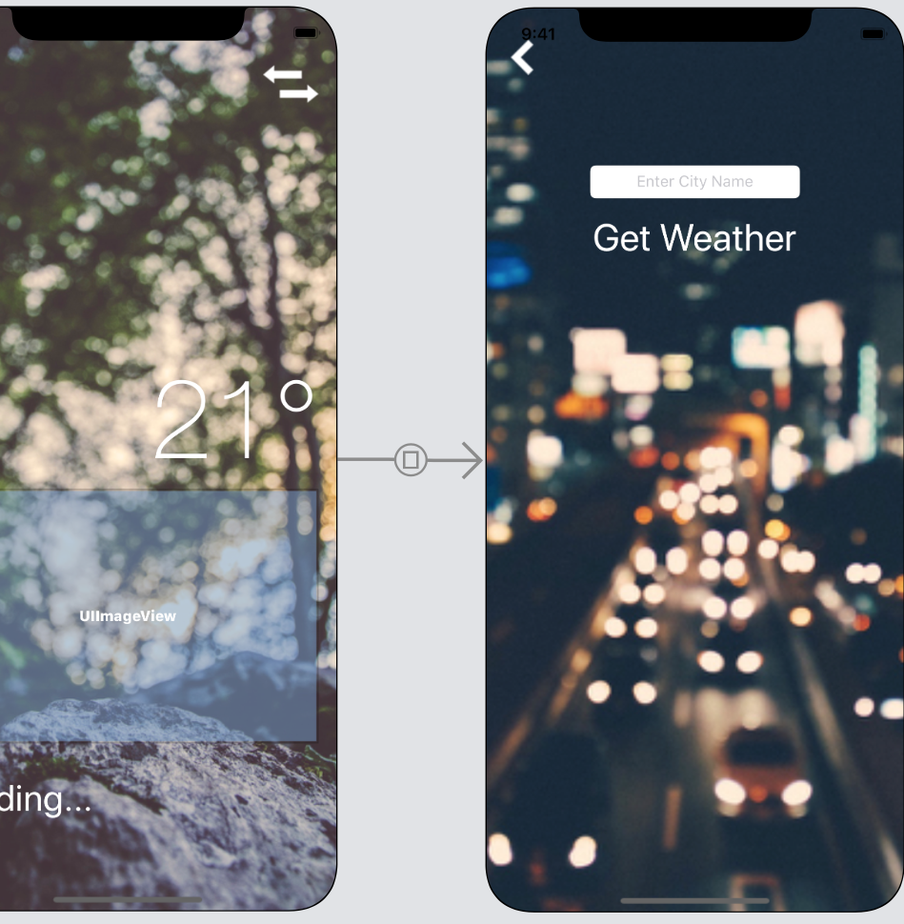
Clima

